Slide 1
Lecture 17: Midterm Review
CSC111: Introduction to CS through Programming
R. Jordan Crouser
Assistant Professor of Computer Science
Smith College

Slide 2
Outline
Jordan-led review and some sample problems
Administrative details
“Ask Me Anything” (30 min)

Slide 3
Topics you should review
Basic hardware (processor, RAM, hard drive, etc.)
Data types (int, float, string, bool, list, dict) and the operations they support
Familiar functions: print, range, eval, input
Exceptions and how to debug them
Conditional statements
Loops (both for and while)
Defining / calling functions

Slide 4
Stuff you should be able to do
Define terms
Describe what a function or line of code does
Read a snippet of code and find / correct common errors
Trace the execution of a short program, including functions that take in parameters and return values
Write a function from a given description

Slide 5
Example problems: hardware
Describe the piece of hardware pictured:
what is it called?
what does it do?

Slide 6
Example problems: data types
What data type is x in this expression?
x = 3

Slide 7
Example problems: data types
What data type is x in this expression?
x = “Boo!”

Slide 8
Example problems: data types
What data type is x in this expression?
x = [“ghost”,
“bat”,
“pumpkin”]

Slide 9
Example problems: data types
What data type is this expression?
“bat” in x

Slide 10
Example problems: numeric operations
What is the result the following expression?
9 + 3

Slide 11
Example problems: numeric operations
What is the result the following expression?
9 + 3.0

Slide 12
Example problems: numeric operations
What is the result the following expression?
9 / 3

Slide 13
Example problems: numeric operations
What is the result the following expression?
9 // 3

Slide 14
Example problems: numeric operations
What is the result the following expression?
9 % 3

Slide 15
Example problems: string operations
Write an expression that returns the value of a string x with all instances of the letter “o” replaced with “oOo”

Slide 16
Example problems: familiar functions
Name 3 built-in python functions, and describe how they work

Slide 17
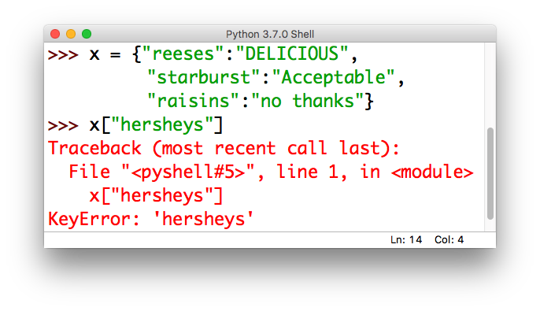
Example problems: exceptions
Describe what the following Exception is telling you about the mistake in the corresponding code.

Slide 18
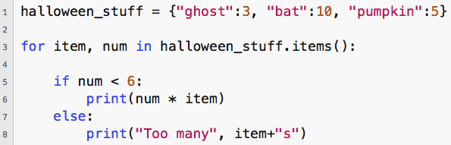
Example problems: reading code
Describe the output of the following script:

Slide 19
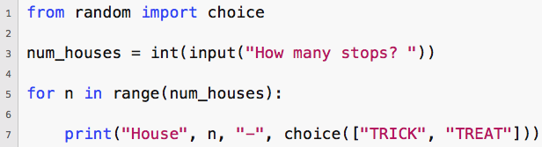
Example problems: user input
Consider the following script:
What happens when the user enters the value 3?

Slide 20
Example problems: user input
Consider the following script:
What happens when the user enters the value 3.0?

Slide 21
Example problems: user input
Consider the following script:
What happens when the user enters the value three?

Slide 22
Example problems: writing functions
Define a function called printInfo(…) that takes in a value, prints out its data type, and then prints the following:
if the value was a string, prints out the length
if the value was a list or dictionary, prints out the number of items
if the value was a dictionary, prints out the keys

Slide 23
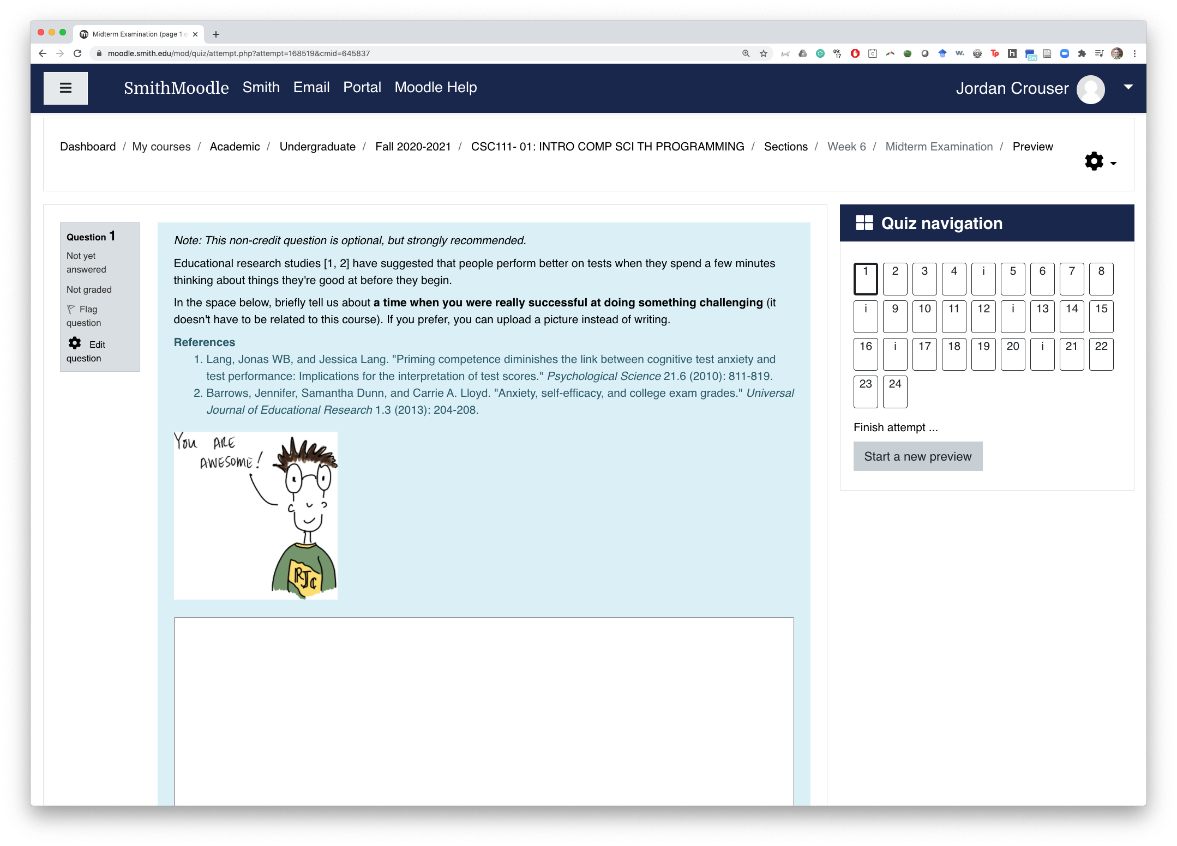
Administrative details

Slide 24
Administrative details
The exam will open at 10:35amEST on Friday 10/16
It will end at 9:00amEST on Friday 10/23
You’re welcome to use repl.it as a scratchpad provided the repl is private / not shared with anyone else:
Get 3 months of repl.it Hacker for free with the GitHub developer pack (unlimited private repls + other cool stuff, see discord for link)
Alternative: use the Python Principles online python interpreter https://pythonprinciples.com/online-python-interpreter (pro: easy, con: doesn’t save)

Slide 25

Ask me anything
What lingering questions do you have?

